Slide 1
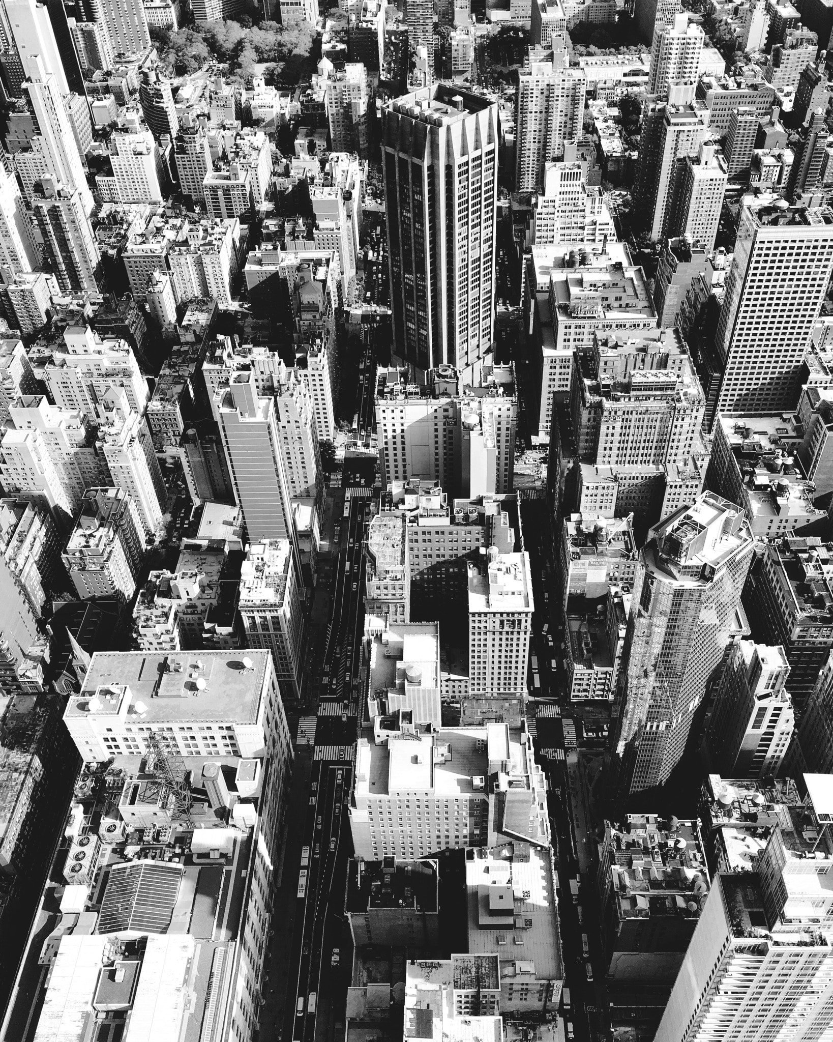
Roof Coatings
Decorative, Protective and
Sustainable Alternatives
Presented by
(insert name)
(insert title)
Provider K065
Notes:
Welcome To: “Roof Coatings – Decorative, Protective, and Sustainable Alternatives”
This presentation illustrates the different options building owners, specifiers, and applicators have available in todays’ marketplace. Typical types of structures, roof substrates, and the various technologies available are discussed and highlighted. Residual benefits of energy savings, sustainability, and durability are also part of the presentation. Case studies are included at the conclusion of the program

Slide 2

Copyright
This presentation is protected by US and International copyright laws. Reproduction, distribution, display and use of the presentation without written permission of the speaker is prohibited.
Notes:
This presentation is protected by US and international copyright laws. Reproduction, distribution, display and use of the presentation without written permission of the speaker is prohibited.

Slide 3
The Sherwin Williams Company, is a registered provider with the American Institute of Architects Continuing Education Systems. Credit earned on completion of the program will be reported to CES Records for AIA members. Certificates of Completion for non-AIA members are available upon request.
This program is also a registered with the International Institute of Building Enclosure Consultants (IIBEC) and Green Business Certification Inc. (GBCI) for continuing professional education. As such, it does not include content that may be deemed or construed to be an approval or endorsement by the AIA/IIBEC/GBCI of any material of construction or any method or manner of handling, using, distributing, or dealing in any material or product. Questions related to specific materials, methods, and services will be addressed at the conclusion of this presentation.
Notes:
The Sherwin Williams Company is a registered provider with the American Institute of Architects Continuing Education Systems. Credit earned on completion of the program will be reported to CES Records for AIA members. Certificates of Completion for non-AIA members are available upon request.
This program is also a registered with the International Institute of Building Enclosure Consultants (IIBEC) and Green Business Certification Inc. (GBCI) for continuing professional education. As such, it does not include content that may be deemed or construed to be an approval or endorsement by the AIA/IIBEC/GBCI of any material of construction or any method or manner of handling, using, distributing, or dealing in any material or product. Questions related to specific materials, methods, and services will be addressed at the conclusion of this presentation.

Slide 4

Learning Objectives
1
Understand the different types of coatings used in roofing.
2
Learn how reflective roof coatings
can impact energy savings,
the environment and roof performance.
Explore how reflective roof coatings can be incorporated into sustainable restoration solutions.
3
4
Identify residual benefits specific to real world case studies.
Notes:
By the end of this course, you will understand the different type of coatings used in roofing, learn how reflective roof coatings can impact energy savings and the environment and explore how reflective roof coatings can be incorporated into sustainable restoration solutions for existing roof substrates.
We will also identify residual benefits specific to real world case studies where reflective coatings have contributed to substantiality as well as energy cost reductions.

Slide 5

Roof Coatings
Notes:
Let’s explore some different types of roof coatings.

Slide 6
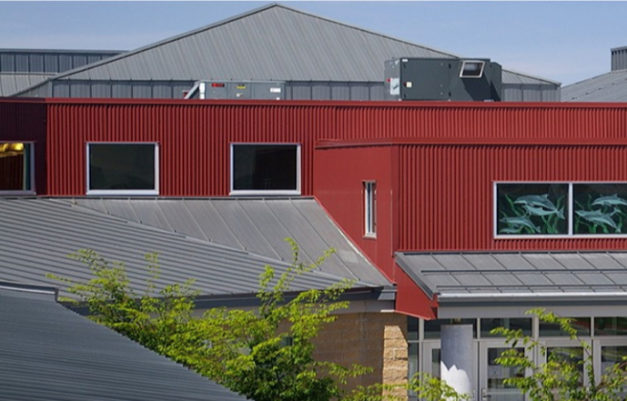
Roof Coatings
FIELD APPLIED PAINT
Colors a Surface
Aesthetics
Provides a desired sheen
Thin film build with minimal elongation properties
Primary uses for architectural metal and tile roofing
Notes:
Field applied roof paint is used primarily for aesthetics and to add color to a roof surface. It provides a rejuvenating appearance and is applied as a thinner wet film, typically 5- 7 mils, with lower elongation than other coatings which we will discuss today.
Field applied roof paints are primarily used on architectural metal panels and concrete tile roofing.

Slide 7
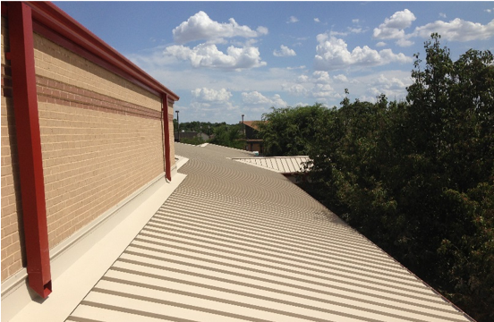
Roof Coatings
FIELD APPLIED PAINT
Roof paints can be used to change the appearance of architectural metal roofs (color).
By design, these types of roof shed water and do not require higher build protective coatings.
Notes:
Consider roof paint when an existing factory finish needs touch-up, or when there is a desire to change color. Paint can be a protective coating to prevent bare steel from corroding as well.
Next we will discuss a category of protective coatings that provide more than simple corrosion protection. Roof paints are used for facades on strip malls, architectural metal roofs in the educational market and residential metal and tile roof applications.

Slide 8
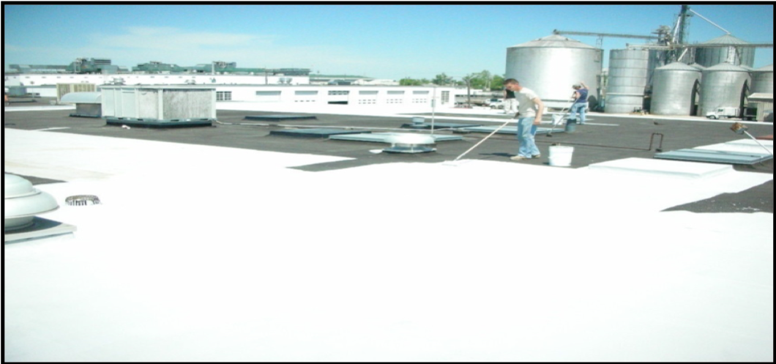
Roof Coatings
PROTECTIVE COATINGS
Designed to shield the substrate from the environment.
Higher film build with more elongation than roof paint products.
Offer reflective benefits
Typically used on low slope substrates and structural metal roofing.
Notes:
Protective roof coatings are designed to shield the roof substrate from the environment. Protective roof coatings are generally applied at higher wet film thicknesses and possess more elongation than roof paint products. Aluminum and white protective roof coatings also offer reflective benefits. Application rates and wet film thicknesses vary based on the type of roofing substrate, the age of the existing roofing system, and on the desired service life.

Slide 9
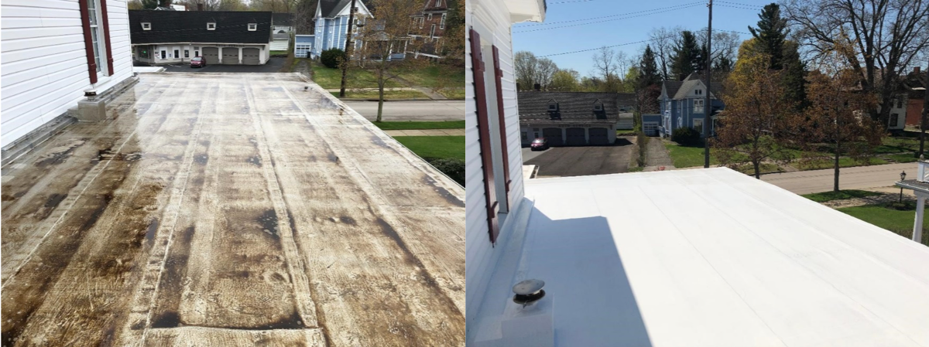
Roof Coatings
PROTECTIVE COATINGS
Commercial and residential applications
Low slope roofs on residential style construction can also benefit from protective coatings
Notes:
Protective coatings also have a place in low slope roofing on residential construction.
Both commercial and residential properties can take advantage of energy cost savings and extending roof service life by utilizing protective coatings.

Slide 10
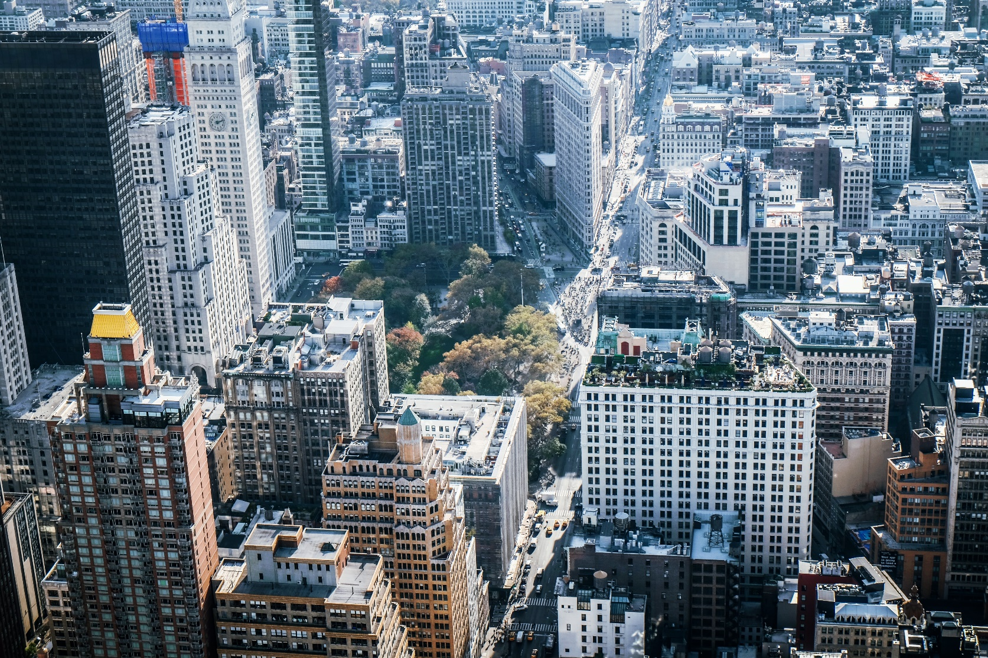
Roof Coatings
TYPES OF PROTECTIVE COATINGS USED IN ROOFING
Asphalt
Aluminum
Acrylic
Silicone
Polyurethane
PMMA (Poly Methyl Methacrylate)
PVDF (Polyvinylidene Fluoride)
Notes:
Asphalt and Aluminum coatings have been used for decades in roofing and have proven performance but low reflectivity.
Acrylic, Silicone and Polyurethane are high performance coatings that offer high reflectivity and have a proven history.
Newer technologies like PMMA and PVDF are also gaining traction in the industry, however PVDF is a thin build paint product that can be incorporated into other technologies such as acrylics to provide protective benefits in addition to aesthetic.
PVDF is commonly used for roof top logos or where long term color retention is desired. For this presentation we will focus on the most common technologies, Acrylic, Silicone and Polyurethane.

Slide 11
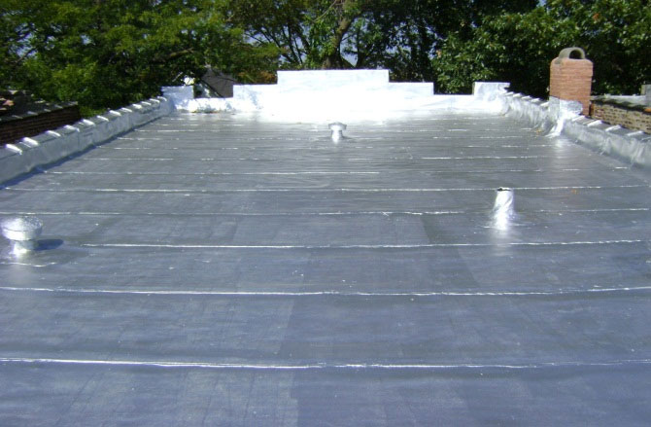
Roof Coatings
  Aluminum Coating over Modified Bitumen
Notes:
This picture is an example of Aluminum roof Coating over a Modified Bitumen Roofing System.
Aluminum roof coatings can be produced utilizing various grades of pigments, aluminum flake or aluminum paste. These raw materials, combined with asphalt deliver durable, reflective properties. Aluminum roof coatings are utilized on asphalt built up roofing or modified bitumen smooth roofing systems.
Aluminum coatings are a cost effective choice for older properties where aluminum has been used in the past as a UV protectant.

Slide 12
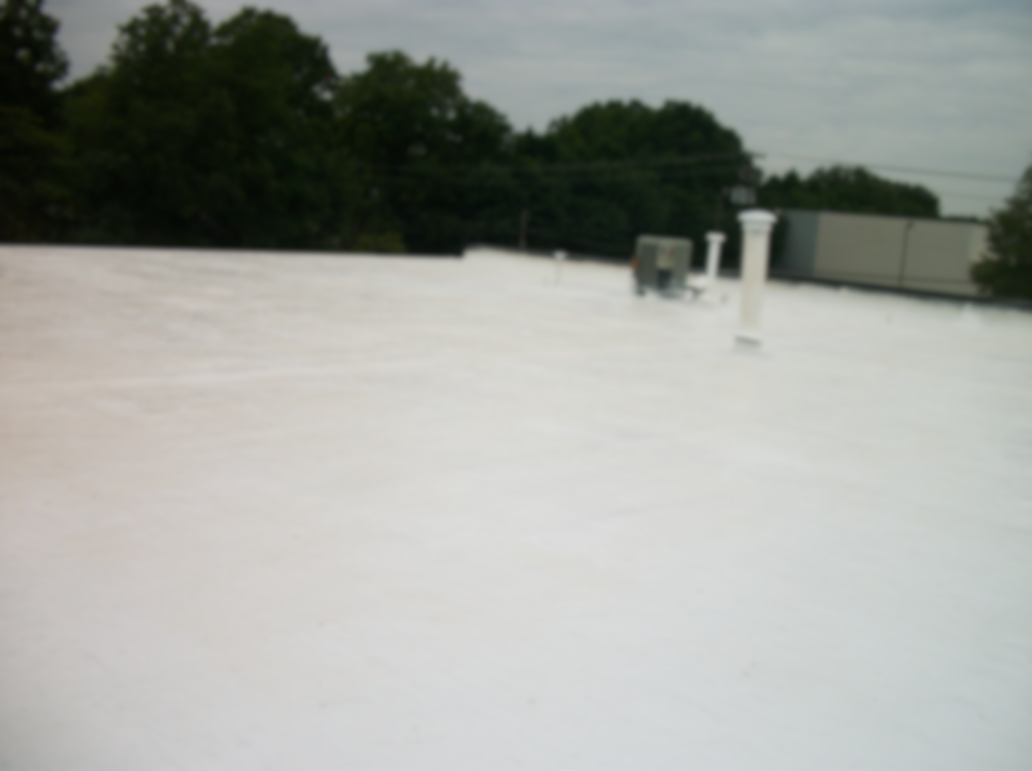
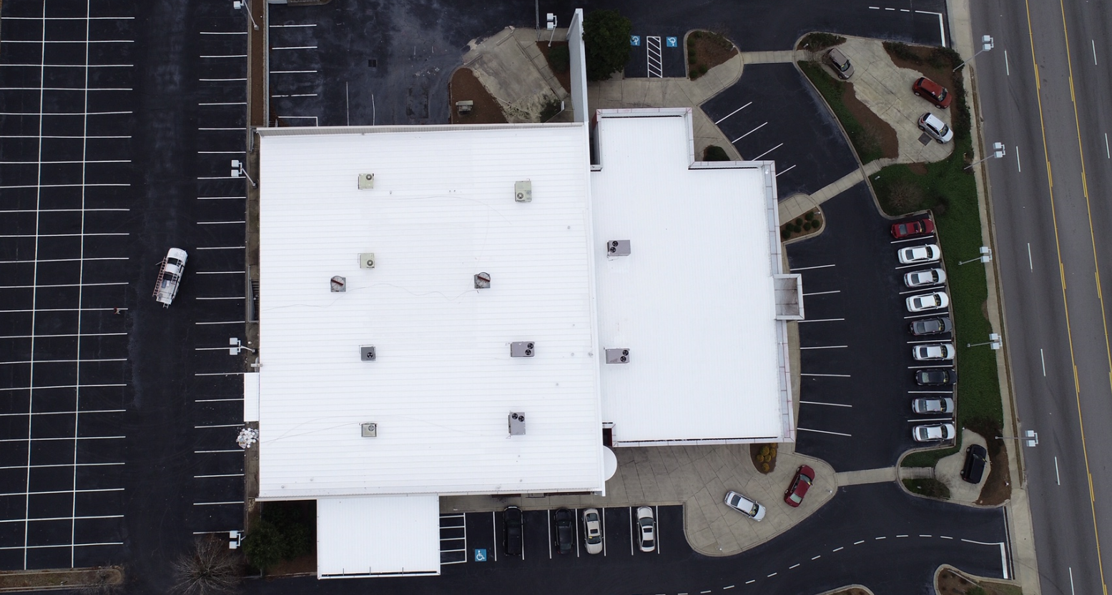
Roof Coatings
Notes:
These are examples of Acrylic coating over Built Up Roofing and Silicone coating on a metal roof.
The picture on the left is an Acrylic Coating over smooth Built Up Roofing.
The picture on the right is a Silicone coating over an EPDM single ply membrane.
Both coating types are bright white and highly reflective.
Both technologies are suitable to be used on either roof substrate.
Also keep in mind that roof drainage should be a key consideration when selecting a roof coating technology. We will discuss this further later in the presentation.

Slide 13
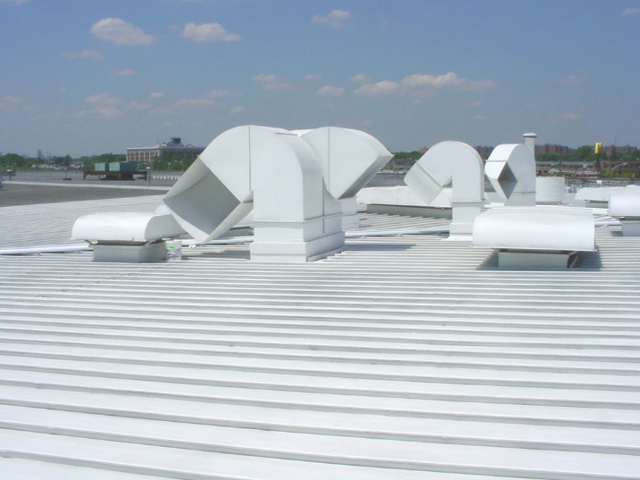
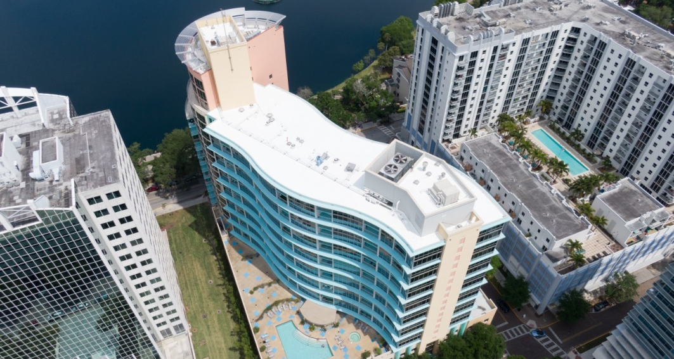
Roof Coatings
Notes:
This is an example of Silicone roof coating over an existing Modified Roofing and Acrylic roof coating on a metal roof.
The picture on the left is a silicone roof coating over an existing modified bitumen roofing system.
The picture on the right is an example of acrylic roof coating over structural metal roofing.
Again, either technology could be used on these roofing substrates.
These coatings are lightweight and contribute very little additional weight to the existing roof system.
The high rise on the left will be discussed further during our case studies.
For now, imagine the cost associated with trying to re-roof this building that has very little staging area and is very high up in the air.
As you can see, these technologies are all bright white and highly reflective. We will discuss why this is important in the next section.

Slide 14

Knowledge Check
Field applied paint and protective coatings differ in the following ways:
Film Build
Neither can be used for metal roofing
Elongation properties
Both A & C
Notes:
Before we move on to learn about how reflective roof coatings provide sustainable roofing options, let’s do a quick Knowledge Check.
Field applied paint and protective coatings differ in the following ways:
Film Build
Neither can be used for metal roofing
Elongation properties
Both A & C
The correct answer is D.

Slide 15

Sustainable Roofing Solutions
Notes:
We will now discuss roof sustainability and the impact on our environment, people, and benefits to help the bottom line of company profits.

Slide 16
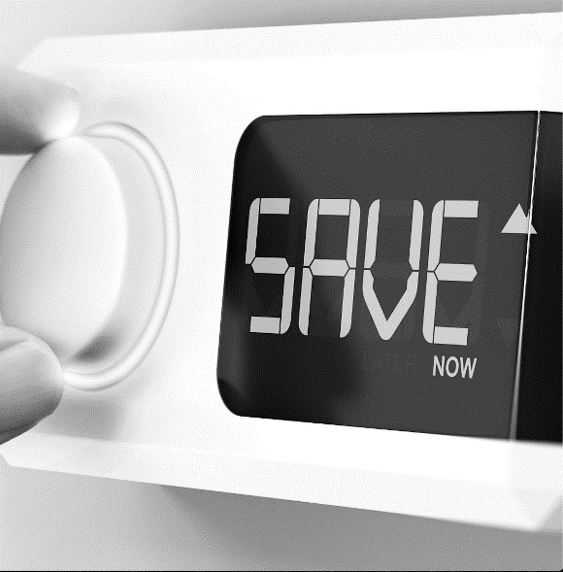

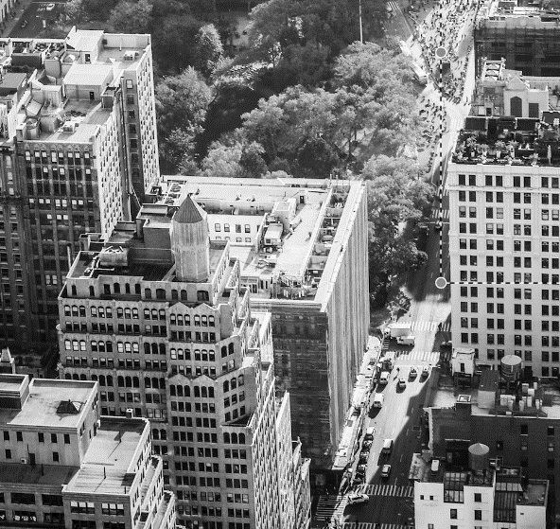
Benefits of Reflective Roof Coatings
Energy
Savings
Environment
Roof Performance
Notes:
Reflective roof coatings offer the opportunity for facility energy savings, are beneficial to the environment and can improve roof performance.
The use of reflective roof coatings reduces our carbon foot print by reducing the amount of energy it takes to cool a structure. With national and global attention on the effects of rising climates, reflective roof coatings have proven to reduce energy consumption by an average of 10% ( as stated by the state of Florida DOE ).
Additionally, reflective roof coatings improve roof performance by protecting the existing roofing membrane from UV and weathering due to moisture.

Slide 17
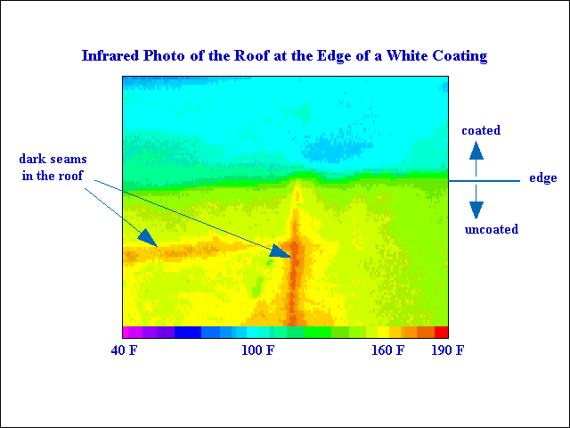

Benefits of Reflective Roof Coatings
Infrared Photo of the Roof at the Edge of a White Coating
Coated
Dark Seams
in the Roof
Edge
Uncoated
40F 100F 160F 190F
Notes:
Reflective roof coatings lower roof surface temperatures.
In this example, the infrared image shows a light blue area indicating 100° F for a section coated with a reflective roof coating.
The yellow area is an uncoated mineral surface cap sheet and indicates a roof surface temperature of 160°F.
This represents a 37% reduction in roof surface temperature.
Also note that the roof seam areas are close to 190° F.

Slide 18
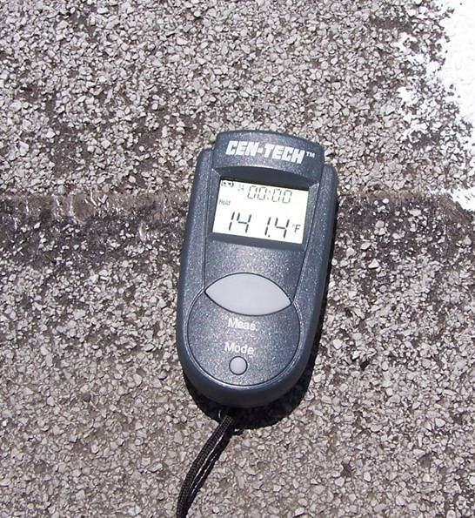
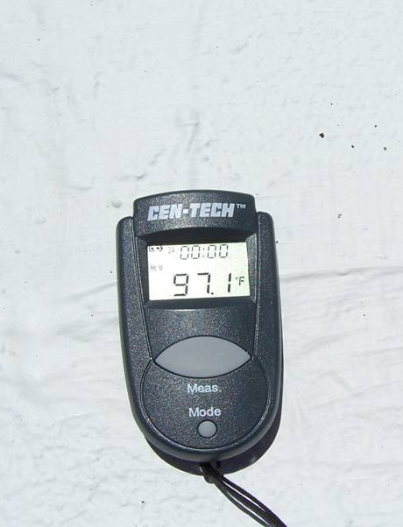
Benefits of Reflective Roof Coatings
Notes:
With todays’ technology, this can also be demonstrated with the use of a thermal heat gun. The uncoated granular surfaced cap sheet is at 141° F while the coated area is 97°F at the same time of the day.

Slide 19




Benefits of Reflective Roof Coatings
Reduces Load on HVAC
Reduces Energy Consumption
Reduces “Carbon
Footprint”
Potential Rebates
Notes:
Lowering roof temperatures can reduce the load and increase the efficiency of rooftop HVAC equipment which can result in the lowering of costs associated with energy consumption and reducing your carbon footprint.
There is also the potential for energy rebates and grants for installing reflective roof coatings. The Roof Coating Manufacturers Association (RCMA) website includes a searchable directory of these incentives by region.

Slide 20

Reflective Roof Coatings
  Roof Coatings Manufacturers Assoc. (RCMA) (https://roofcoatings.org/reflective-roof-rebates-database/)
Notes:
The national energy rebates can be found on the RCMA website and is free to the public. All rebates included in the RCMA website should be verified with the specific energy firm or agency to assure the current status of the rebate program is still active. It is also suggested to confirm the expiration date of the incentive program to assure it aligns with project timelines.

Slide 21


Reflective Coatings: How Do They Do It?
Solar Reflectance (Reflectivity) - the ability of the roof surface to reflect solar radiation. Typically expressed in decimal format (i.e., 0.70)
Thermal Emittance (Emissivity) – the ability of the roof surface to release heat from the roof back into the air. Typically expressed in decimal format (i.e., 0.90)
Solar Reflectance Index (SRI) – a measure of the roof's ability to reject solar heat and uses a scale from 0 to 100. Materials that absorb and retain solar radiation have a lower number, while highly reflective materials have a higher number. SRI is referred to in LEED, ASHRAE and ICC
Notes:
Now let’s review how these roof coatings work to reduce temperature.
To understand this we must first review some terminology.
Solar Reflectance or Reflectivity is the ability of the roof surface to reflect solar radiation.
Thermal Emittance or Emissivity, is the ability of the roof surface to release heat from the roof back into the atmosphere.
Both of these values are usually expressed as a decimal ranging from 0-1.
The higher the number, the better the materials ability to increase thermal efficiency and to reduce temperatures.

Slide 22
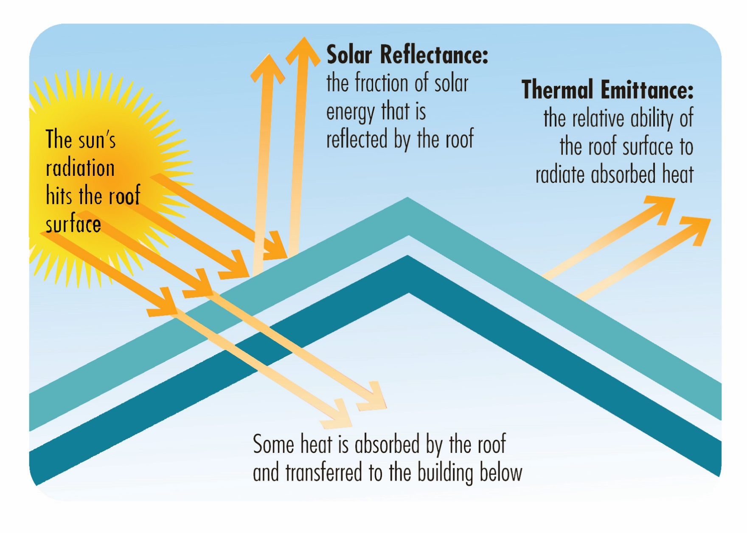
Reflective Coatings: How do they Do It?
Notes:
As the sun’s energy hits the roof surface, a portion will be reflected away because of Solar Reflectance.
Some surface heat will be absorbed by the roofing assembly.
Thermal Emittance will determine how well the roof can radiate this absorbed heat.
The combined effect of Solar Reflectance and Thermal Emittance is commonly referred to as SRI, or Solar Reflectance Index.

Slide 23

Benefits of Reflective Coatings
Environment
Waste Reduction
  Roofing materials are the 3rd greatest contributor to waste in landfills. Roof coatings prolong the roof life and prevent tear-off and waste.
Air Quality Improvement
  Reflective roof coatings reduce smog and improve air quality by lowering ambient temperatures.
Notes:
In addition to the potential for energy savings, Reflective Roof Coatings are also beneficial to the environment by reducing landfill waste associated with roof replacement. Costs related to roof removal and waste site capacity has and will continue to put pressure on the cost of reroofing.

Slide 24


Benefits of Reflective Coatings
Roof Performance
Most effective, least costly option to save energy in low slope roofing in residential, commercial, and industrial buildings
Extend the life of the roof by preventing water, chemical, or physical damage
Prolong roof system life cycle by reducing “thermal shock” stress of large temperature changes
Certain roof coatings even provide an extra level of waterproofing protection to help shed water to keep building interiors dry
Notes:
Reflective Coatings can also impact roof performance by extending the life of the roof by preventing water, chemical or physical damage and at the same time, reducing the stress of thermal shock. Some reflective coatings can also provide an extra level of waterproofing by shedding water.
Although most reflective coatings are not considered waterproof, incorporating them into a broader program can create sustainable solutions to keep buildings weathertight.
We will explore this in the next section.

Slide 25
Knowledge Check
Benefits associated with reflective roof coatings are:
Reduce roof top temperature
Reduce landfill waste
Reduce thermal stress of roof system
All of the above
Notes:
Let’s review what we’ve learned in this last section.
Benefits associated with reflective roof coatings are:
Reduce roof top temperature
Reduce landfill waste
Reduce thermal stress of roof system
All of the above.
The correct answer is D: All of the above

Slide 26
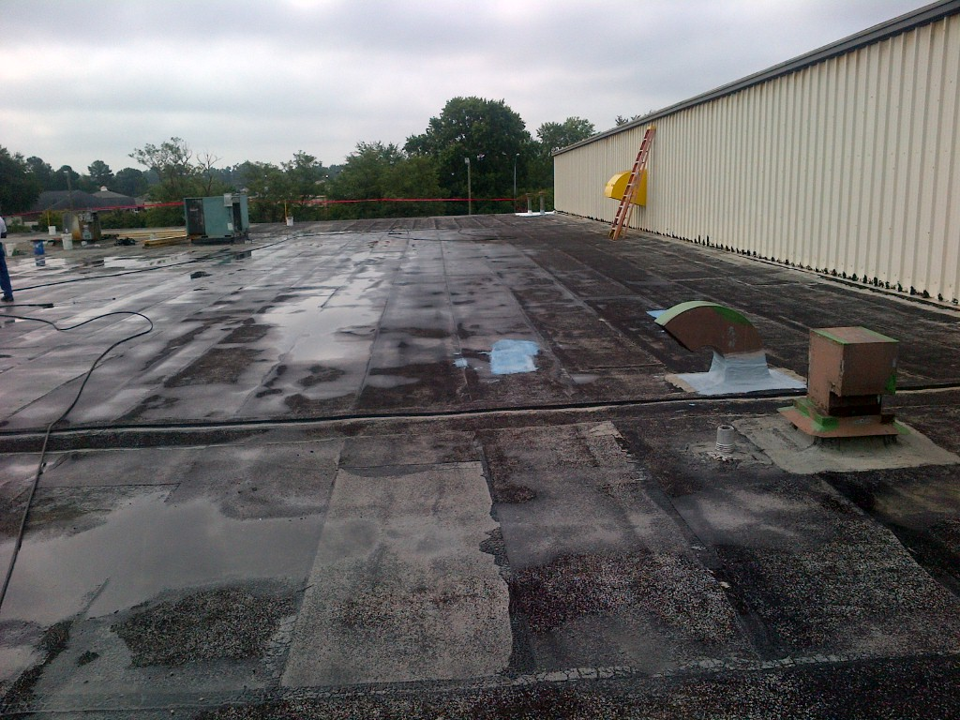
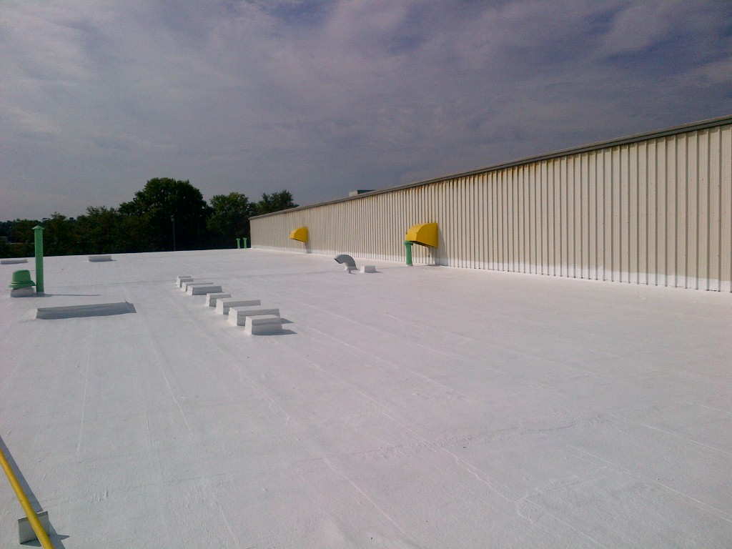

Sustainable Roofing Solutions
“Before & After”
Notes:
Now that we understand the benefits of reflective coatings, let's explore how we can use them in a long term sustainable solutions.
This aged modified bitumen roof system had extensive granular loss and although otherwise generally sound, was starting to develop leaks. Rather than replacing the entire roofing system, the owner opted to restore the roof.
After a thorough evaluation, it was determined that there was minimal wet insulation to be replaced from the leak issues. After repairs were made, a highly reflective protective coating system was installed, extending the useful service life of the roof and the need for tear off and disposal.

Slide 27
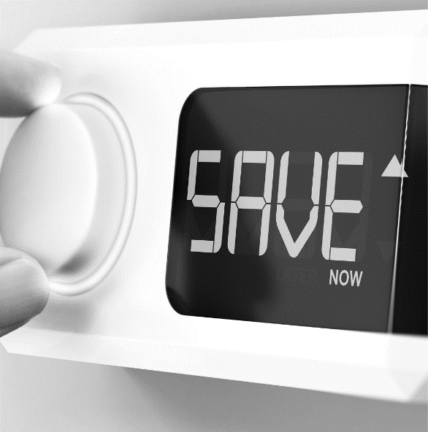
Sustainable Solutions
What is a “Sustainable” Roof?
International Council for Research and Innovation in Building and Construction…formerly CIB
Minimizes Burden
On Environment
Conserves Energy
Extends Roof Life Span
Uses earth’s resources responsibly
Improves the
thermal efficiency
of roof
Improves
long-term performance
Notes:
What is a sustainable roof?
According to the International Council for Research and Innovation in Building and Construction, a sustainable roof:
Minimizes the burden on the environment by using the earth’s resources responsibly.
Conserves energy by improving the thermal efficiency of roofs.
Extends roof life span by improving long-term performance
What are the other things we need to consider to make this a long term sustainable solution?

Slide 28







1990
Sustainable Solutions
1995
2000
Project
Evaluation
Exacting
Specifications
Quality
Manufacturer
Warranty
Considerations
Approved
Contractor Program
Preventative Maintenance Plan
Determine Appropriate Technology
2005
2010
Notes:
Key areas to consider when developing a sustainable solution with reflective coatings are:
Project evaluation
Determine appropriate material technology
developing exacting specifications
Qualify Manufacturer capabilities
Warranty Considerations
Manufacturer Approved Contractors and having a
Preventative Maintenance Plan
Let’s look at each of these in more detail

Slide 29
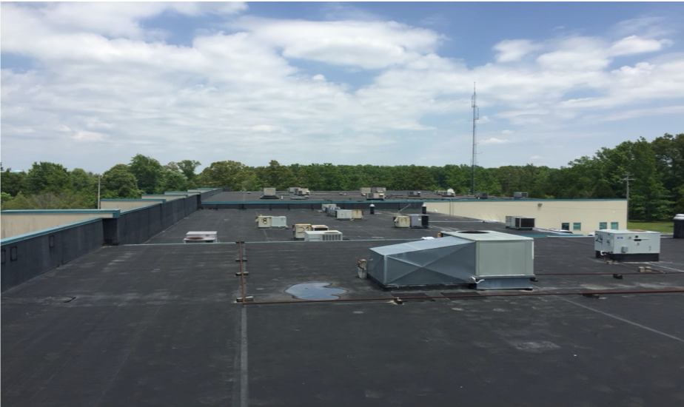
Sustainable Solutions
PROJECT EVALUATION
Roof Condition Survey
  Structural viability of roof assembly
  Roof Assembly meets current code requirements
  Moisture Survey/Roof Core Sampling
Notes:
The first step should be to conduct a comprehensive roof condition survey or assessment.
This should include a review of the structural viability of the roof assembly including the underside of the structural roof deck.
Although applying coating is not considered an additional roof, if there are more than two roofs in place, this could indicate other hidden issues.
A roof moisture survey should also be performed to determine insulation conditions and to identify wet insulation that requires replacement.
Nondestructive testing should be verified by roof core sampling. Roof Core samples will also assist with the number of roofs in place and thickness of insulation if replacement is required.

Slide 30
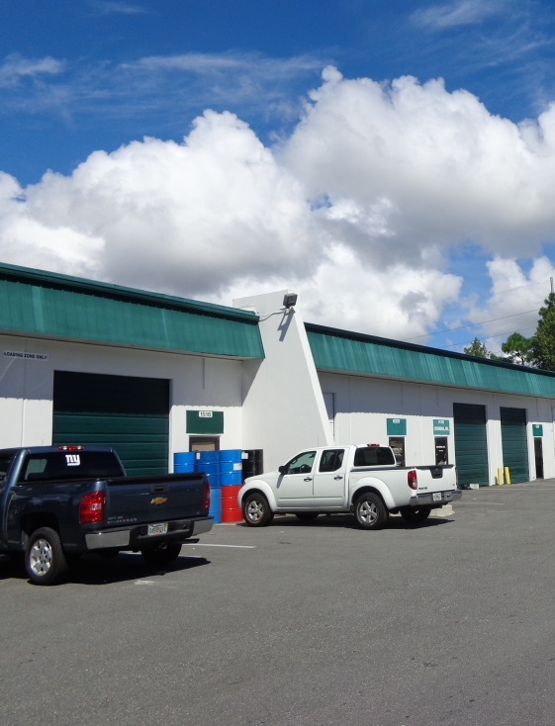
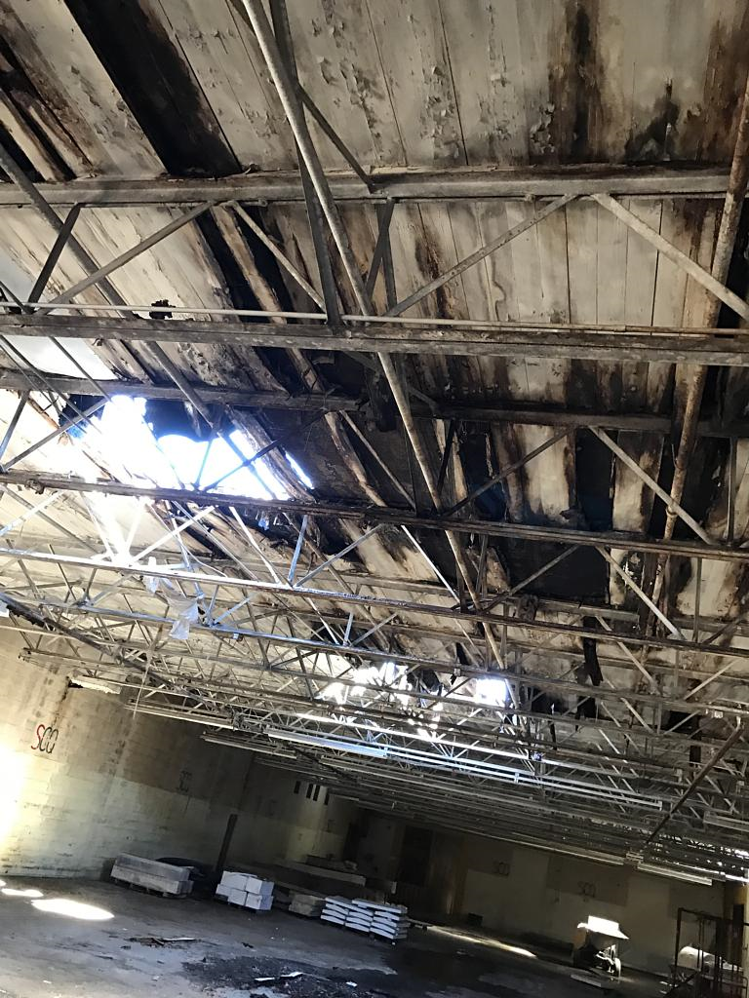
Project Evaluations
Outside, Inside, And THEN …
Notes:
When conducting a roof condition survey it is always a good practice to start with a perimeter walk of the structure to observe issues such as settlement of the foundation and structural cracks along the roof to wall transition.
Next look at the decking from inside whenever possible to assess condition and type.
It’s important to discuss existing and past leak issues with owners whenever possible.
Valuable information can be gained before accessing the roof.

Slide 31
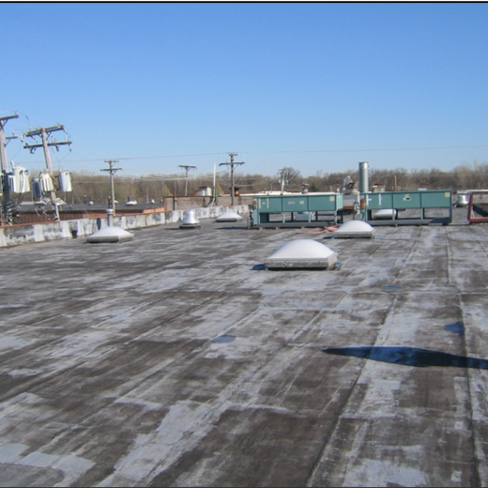
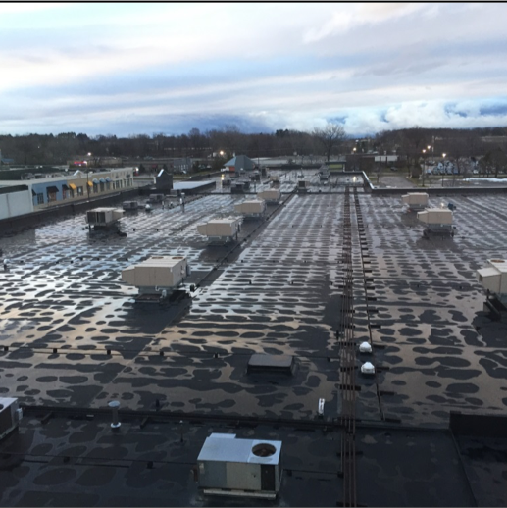
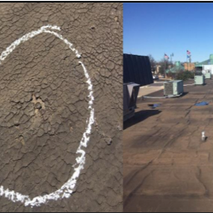
Up on the Roof
“Attention To Detail”
Notes:
Attention to details of the roof surface and the proper time of the day to make the inspection increase the understanding of the roof conditions and past weather events.
NOTE the picture in the middle where individual plastic caps hold down the EPDM mechanically attached roofing membrane. Each fastener is transmitting heat from the inside causing the surface morning dew to dissipate at the fastener head!
The picture on the right illustrates a hail damage impact on the smooth built up roof in place

Slide 32
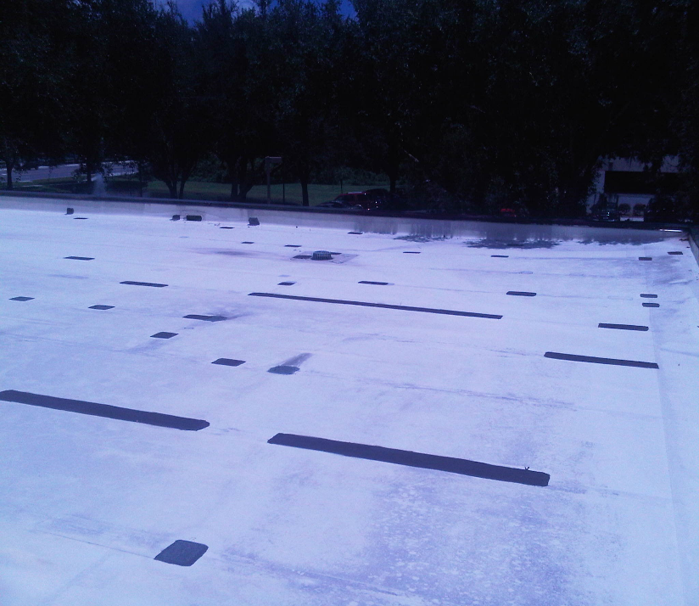
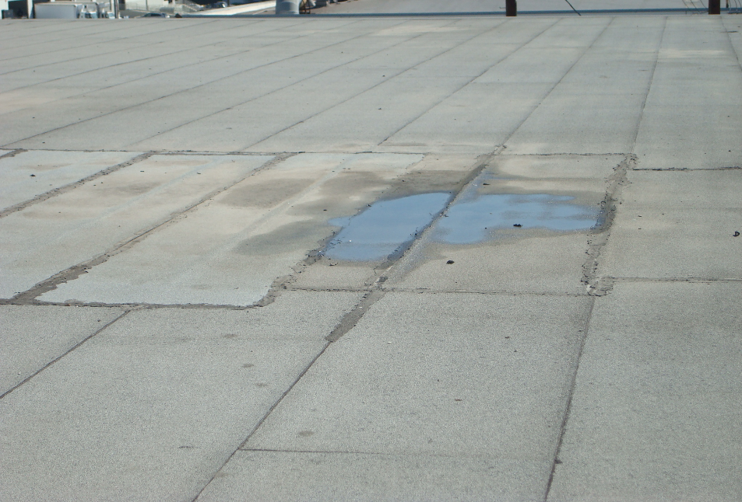
Investigate ALL Previous Repair Issues
Notes:
Whether single ply or modified bitumen cap sheets, existing repairs must be investigated. Further investigation by nondestructive moisture testing such as Thermal Imaging (infrared), Nuclear, or Impedance Testing can reveal larger issues.
Nondestructive testing should always be verified by core sampling.

Slide 33
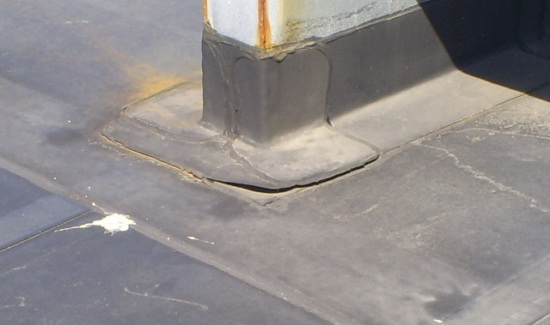
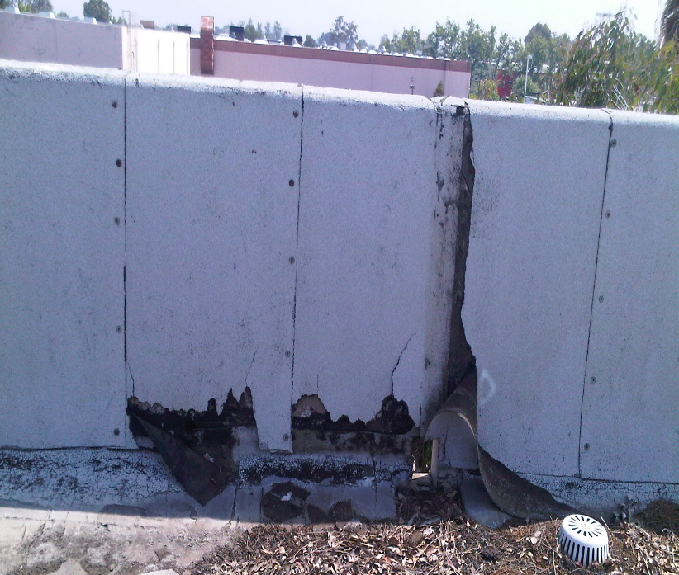
Inspect & Repair ALL Existing Flashings
“Repair v. Replacement”
Notes:
When inspecting existing conditions and repairs, some are simple to repair as illustrated to the left where a simple re-sealing of the flashing seam to maintain weathertightness as compared to the severity and need for full replacement of the parapet wall flashing would be required as illustrated to the right.
Repairs are conducted prior to pressure washing to avoid injecting water into the roof assembly.

Slide 34
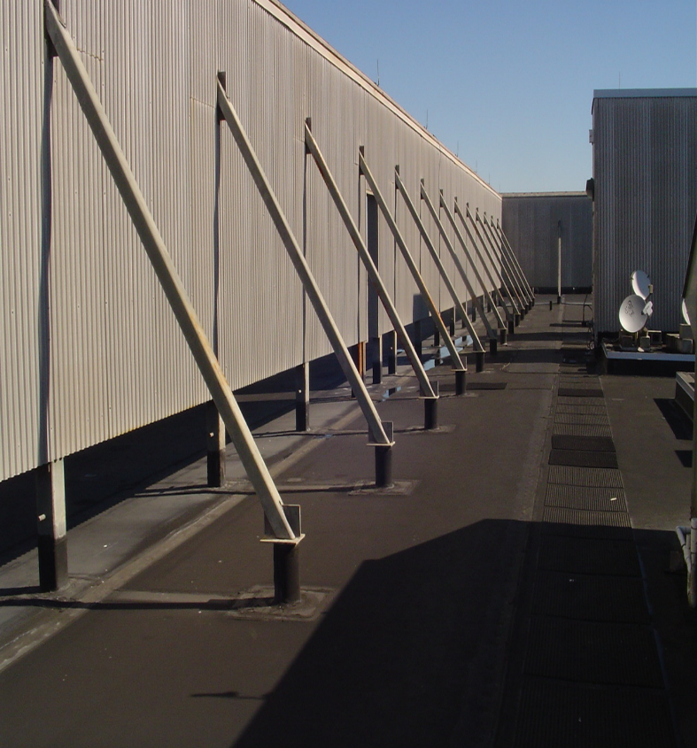
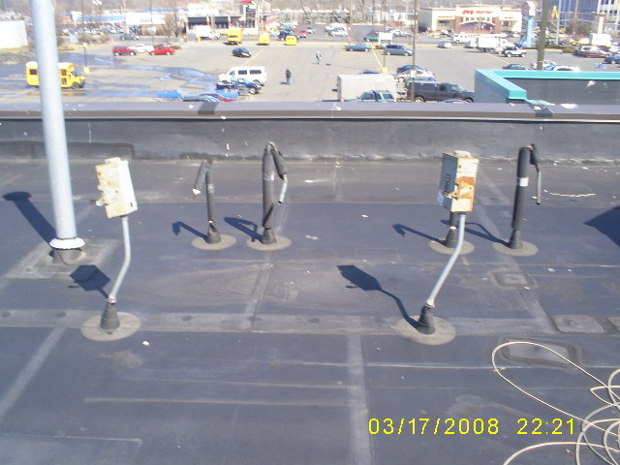
Evaluate Penetration Flashings
“Deal With Them or Delete Them”
Notes:
ALL penetrations are inspected and evaluated for functionality, repair or removal. The more flashing detail to deal with, the more cost effective a roof coating system becomes versus conventional low slope commercial roofing options.
If a penetration is no longer in use it should be removed. This reduces trip hazards as well as additional areas of potential water intrusion.

Slide 35
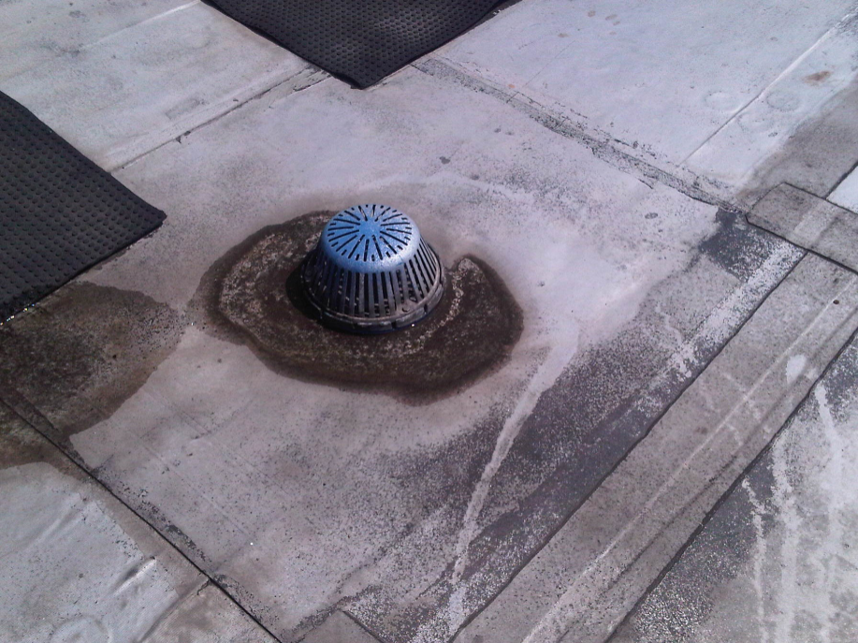
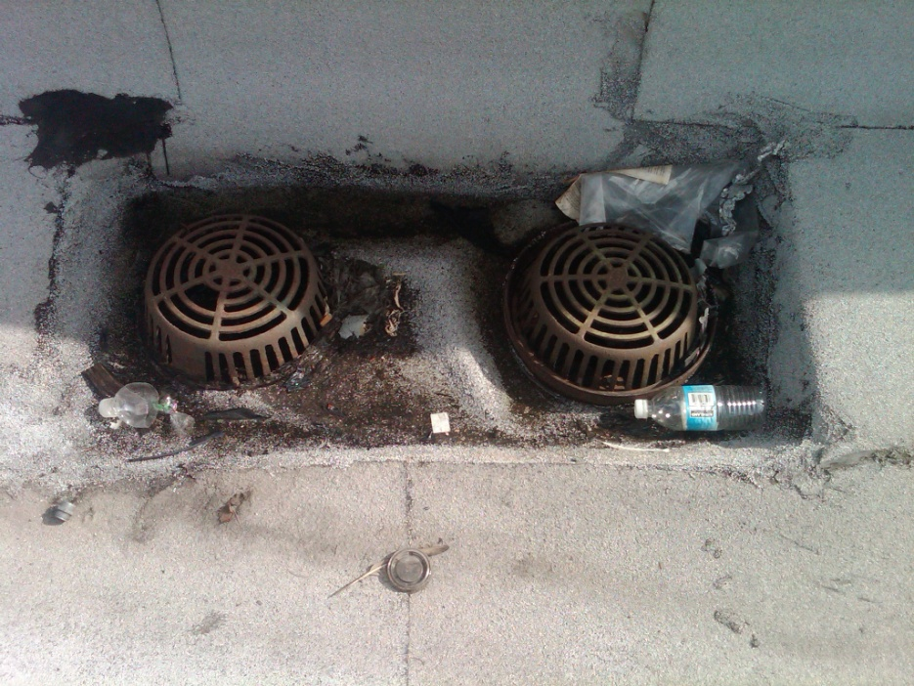
Inspect Roof Drains
“Replace Missing Drain Covers ASAP”
Notes:
All drains and drain covers are inspected to assure proper functioning. Any drain covers that are missing should be identified and communicated to the building owner/property manager immediately.

Slide 36
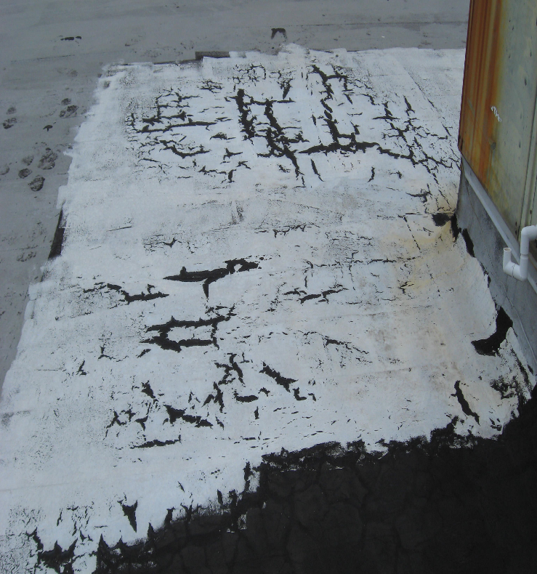
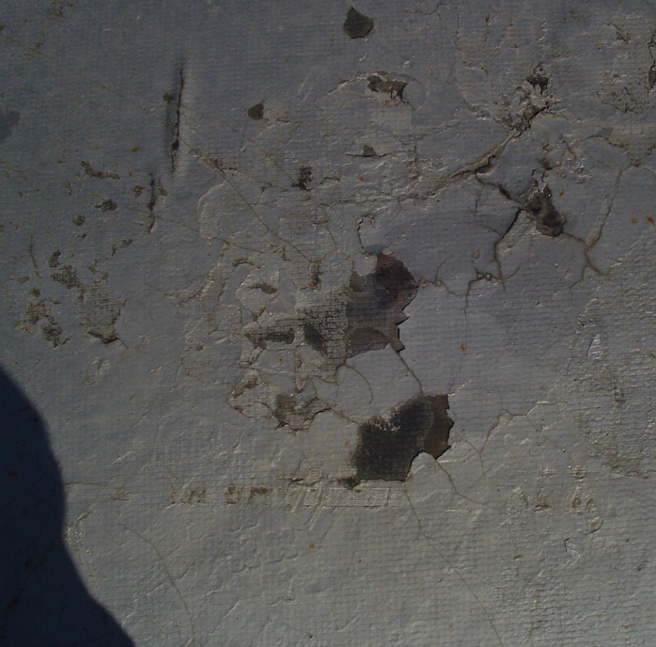
Evaluate Substrate Surface Condition
“Irregular Surfaces v. Lack of Adhesion”
Notes:
When evaluating the existing conditions, flaking or excessive materials can pose an adhesion issue.
Various types of adhesion tests are used to determine suitability of a coating over an existing roof substrate as well as suitability to coat over existing coatings.
Asphalt exhibiting alligatoring conditions may not be fully adhered to the substrate and should be removed when possible. When removal is not practical, these conditions may require additional roof preparation prior to coating.

Slide 37
Knowledge Check
Project Roof Evaluations should include:
Perimeter Walk of the structure
Visual observation of the underside of structural decking
Visual Inspection of the roofing substrate
All of the above
Notes:
Let’s do a quick Knowledge Check to review what was covered in this last section.
Project Roof Evaluations should include:
Perimeter walk of the structure
Visual observation of the underside of the structural decking
Visual inspection of the roofing substrate
All of the Above
The correct answer is D: All of the above

Slide 38

Sustainable Solutions
Determine appropriate material technology
  Adhesion Testing
Exacting Specifications
ACRYLIC
Attributes
POLYURETHANE
Attributes
SILICONE
Attributes
Available in light, reflective colors
UV resistant
High permeance
Water resistant
Cost effective
Water-based
Curing is greatly affected by weather
Easy to re-coat, may need a primer
Good abrasion resistance
Durable
Low to medium permeability
Good elongation
Good chemical resistance
High tensile strength
Solvent-based
Least fire-resistant than other coatings
Easy to re-coat, may need a primer
Available in light, reflective colors
Water resistant
UV resistant
Excellent weather resistance
Good elongation
Moderate abrasion resistance
Typically solvent-based
May be difficult to recoat
Notes:
The next step would be to determine which technology would be the best fit for the project conditions. Each technology has slightly different attributes that should be considered.
You should always conduct an adhesion test to make sure that the technology selected will properly adhere to the substrate. Select the technology that has the best attributes for your project needs.
Consult manufacturers for assistance with any primers that may be required and detailed installation specifications.

Slide 39
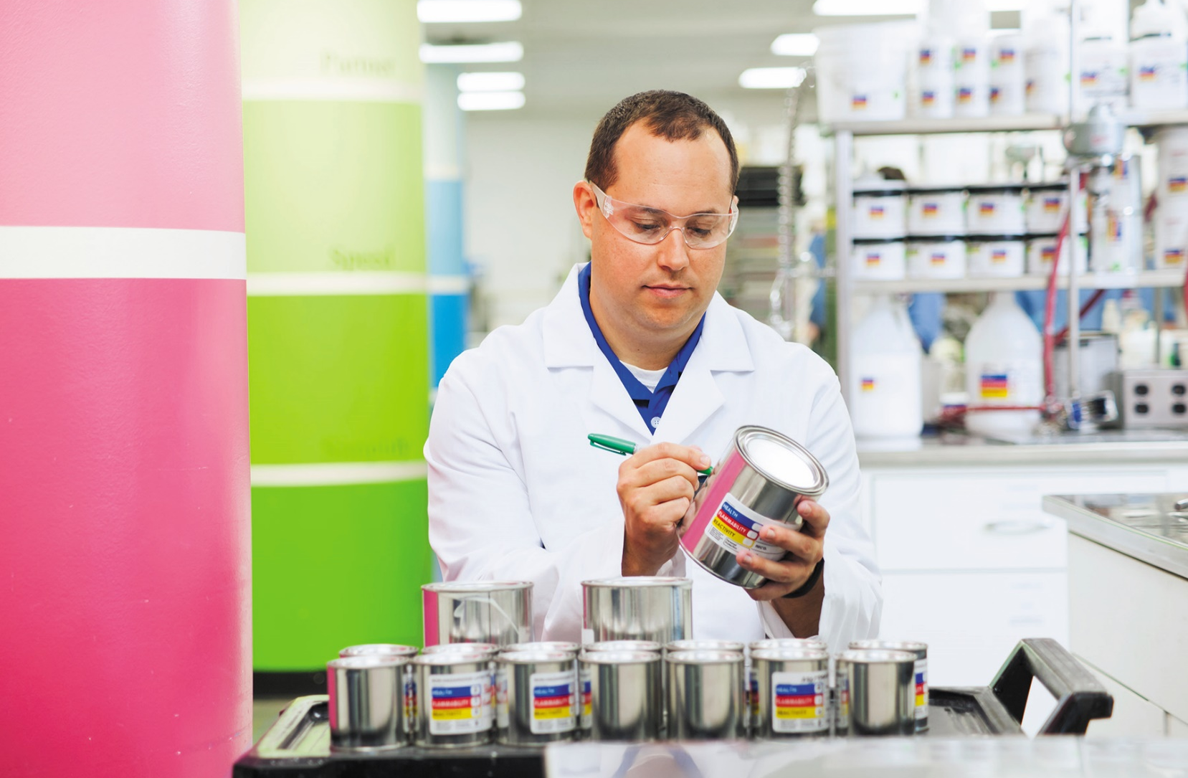
Sustainable Solutions
Qualify Manufacturer
  Financially stable
  Years of experience in technology
  Manufacturing Standards (ISO)
  Technical Support
  Commitment to R & D
Notes:
When selecting a manufacturer, do some research on their qualifications.
Are they financially stable?
How long have they been involved with the technology of choice based on the roof evaluation?
What are their manufacturing standards? Are they ISO registered?
Is there a dedicated technical support staff other than their sales force?
What is their investment and commitment to R&D?

Slide 40
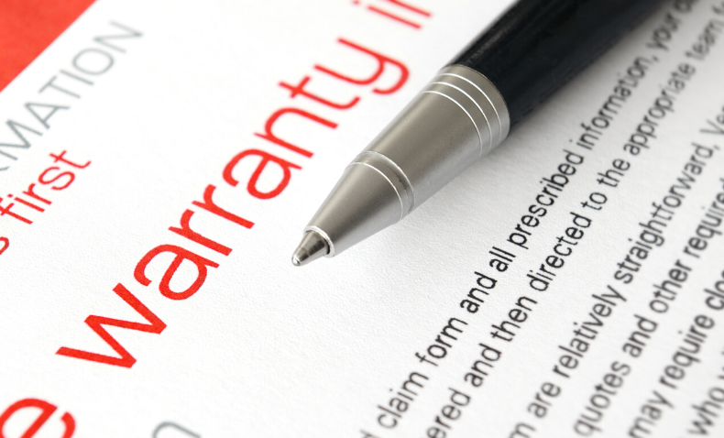
Sustainable Solutions
Warranty Considerations
  Term vs. Renewable
  Who holds the warranty ?
  Owner requirements
Notes:
Many manufacturers also offer warranties. While a warranty never prevented a leak, they do provide peace of mind should an issue arise in the future.
Most warranties are for a fixed term, however renewable warranties are also available. Renewable warranties may allow for additional term extensions without having to do all the prep work required the first time around.
Determine who actually holds the warranty. A Manufacturer that holds their own warranties may have more interest in your long term satisfaction than a manufacturer that uses a third party holder.
Finally, also determine what your responsibilities are to maintain the warranty.

Slide 41

Sustainable Solutions
Manufacturer Approved Contractors
  Manufacturer training
  Experience In the technology selected
  References
  Licensing & insurance requirement
  Safety & equipment Continuing Education programs
Notes:
Selecting a contractor is also an important item to research. Most manufacturers can provide a list of contractors that have had some level of training in the installation of their products.
Contractors should be able to demonstrate their level of experience in the selected technology . References are a great source for this information.
They should also have proper licensing and insurance.
Always ask for and review their safety plan for your project.

Slide 42
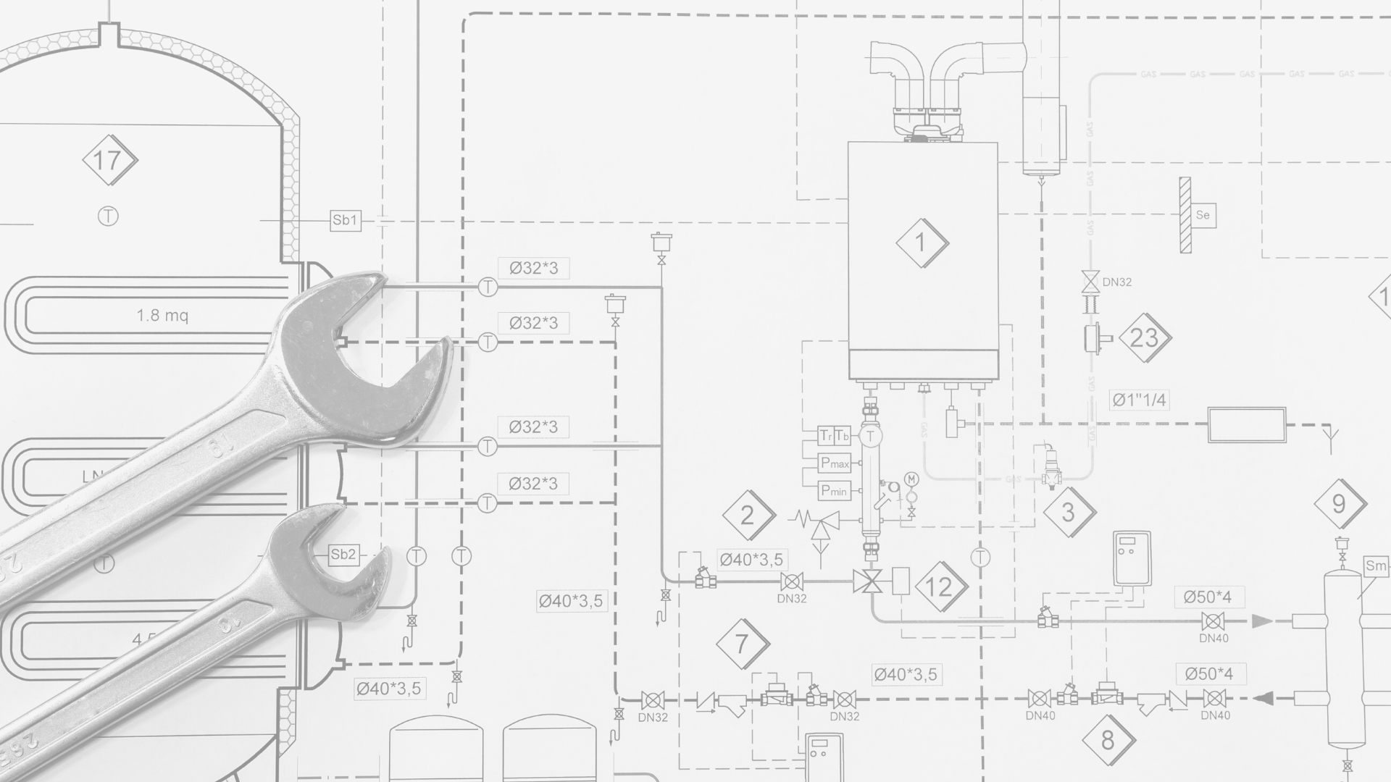
Sustainable Solutions
Preventative Maintenance Plan
. According to a recent survey, preventative maintenance programs extend roof life by 30-60%.
Consequently, the first step towards making the roof an asset
is preventative maintenance .
”The decision not to employ an aggressive roof maintenance program is costing owners between $0.10 and $0.15 per sq. ft. per year.”
- Dennis Firman, P.E., US Air Force
Notes:
Once your new sustainable reflective roof solution is installed, don’t forget to have a preventative maintenance plan in place.
Many contractors offer this service and many manufacturers require some type of maintenance as a requirement of their warranty.
Preventative maintenance programs have proven time and time again to be valuable in extending roof service life and minimizing costs.
Bi- annual inspections in the spring and fall can uncover minor issues that left unattended can turn into major concerns.

Slide 43
Knowledge Check
A Roof Condition Survey should include:
Specifications
Moisture Survey
Adhesion Test
None of the Above
Notes:
Before we move on to Case Studies, let’s take a minute to review what was covered in the last section.
A Roof Condition Survey should include:
Specifications
Moisture Survey
Adhesion Test
None of the Above
The correct answer is B: Moisture Survey

Slide 44

Notes:
Let’s take a look at some real world case studies where Sustainable roof coatings have had an impact.

Slide 45
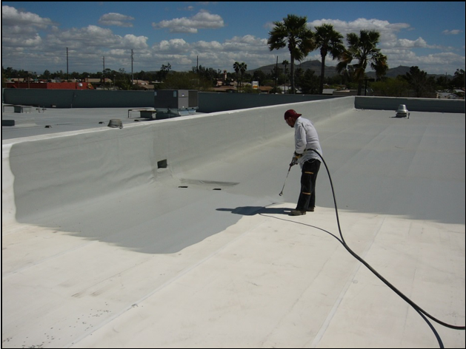
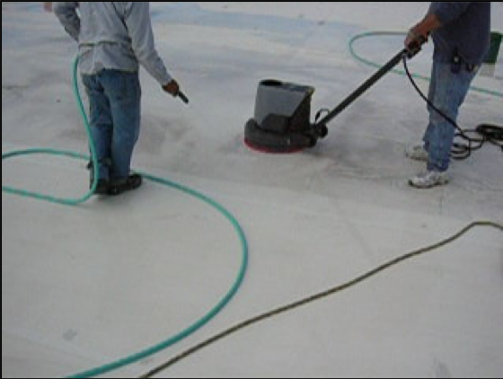
Case Study #1
PVC Membrane Restoration
Notes:
In this case we will look at an instance where a sustainable roof coating system provided additional protection to a PVC membrane during a hail event.
The PVC membrane was cleaned and a 2 coat acrylic coating system was applied.

Slide 46
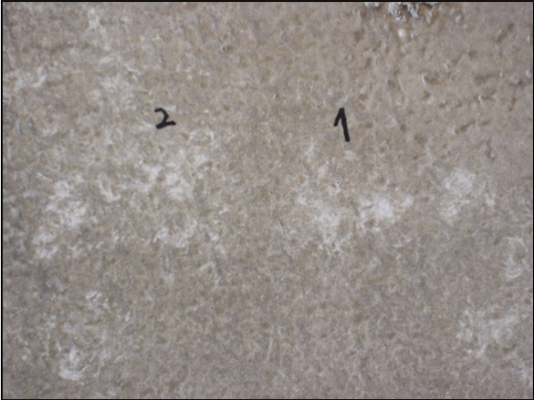
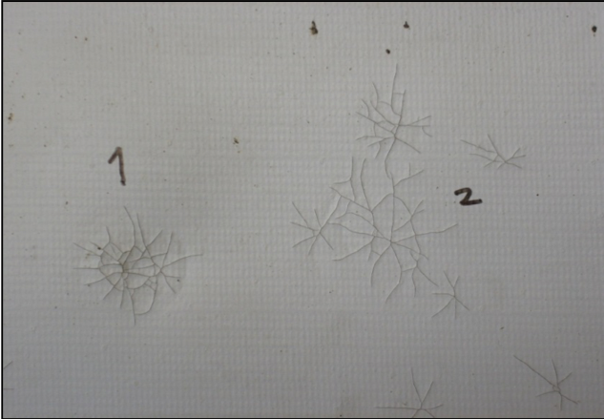
Case Study #1
Roof Sample Illustrates Aged PVC Membrane with hail damage
Condition Observed on Both On Topside and Underside of Membrane
“Residual Benefit – Insurance Claim For Roof NO Water Damage”
Notes:
After the hail event, damage was visible on both the topside and underside of the affected roofing membrane.

Slide 47
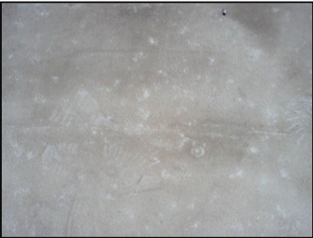
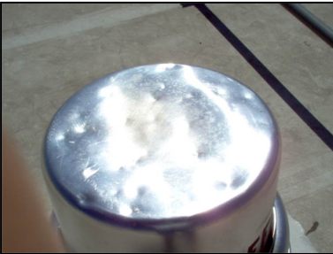
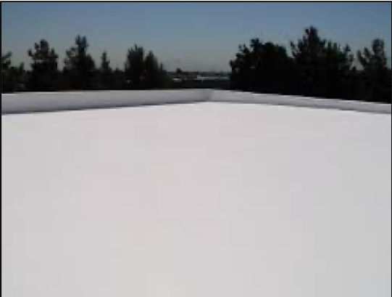
Case Study #1
NO LEAKS!
No inventory lost! Savings from this occurrence more than paid for the project.
No recover or tear-off required!
Notes:
Although the PVC Single-ply membrane suffered hail damage, the acrylic coating system while marked, remained intact and protected the damaged single-ply membrane from leaking. This resulted in no loss of inventory and no need to recover or tear off the membrane.
The savings from this occurrence more than paid for the cost of the project.

Slide 48
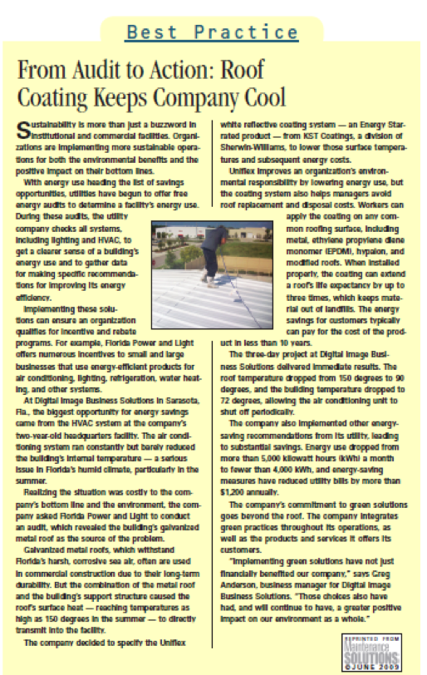
Case Study #2
Sarasota, FL
Metal Roof
Roof Temperatures Dropped From
150ºF To 90 ºF
Interior Temperatures Dropped To 72ºF
20% Reduction In KWh Usage
Notes:
After applying a reflective roof coatings system, one company in Sarasota Florida keep track of temperatures and energy consumption.
Roof temperatures were reduced from 150°F to 90°F.
Interior temperatures were also reduced allowing for the HVAC units to shut off periodically.
A 20% reduction in kilowatt usage was also tracked resulting in additional cost savings.

Slide 49
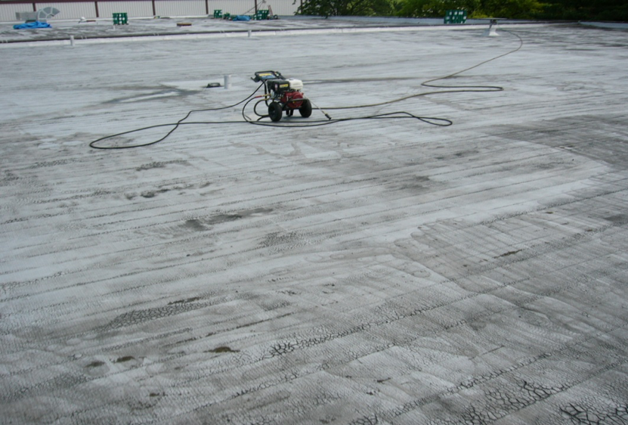
Case Study #3
60 year old factory, 65,000 square feet, air conditioned space
4-ply smooth asphalt BUR, 13 yrs. old with aluminized asphalt coating, 5 yrs. old
No leaks, dry by IR thermography, incidental standing water, ¼” slope
R-value of 16 (when newly installed)
Notes:
Case Study #3 is also about energy savings.
An existing factory with a 13 year old Built up roof had a 5 year old aluminized asphalt coating in place.
The roof system itself was sound with no reported leaks and confirmed by infrared thermography.

Slide 50
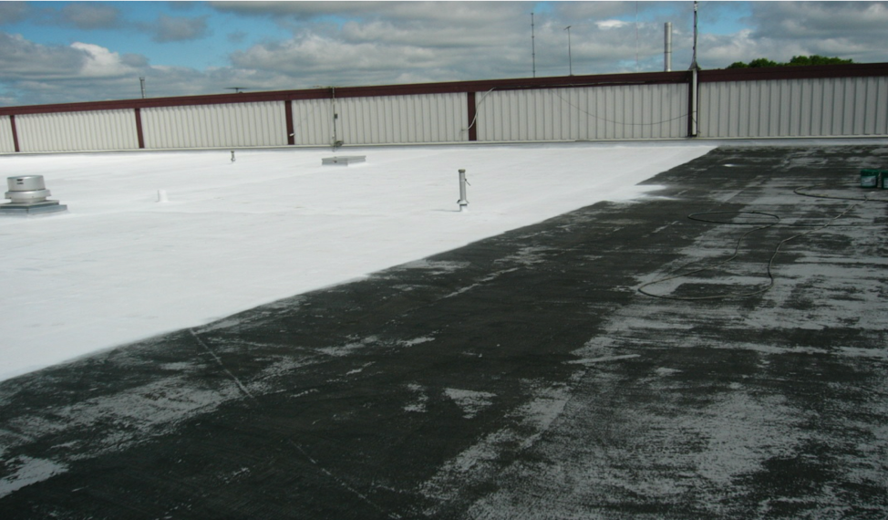
Power wash off dirt and most of asphalt coating
Prime / Base of ½ - ¾ Gal/Sq asphalt compatible acrylic coating
Fabric reinforcement at penetrations / curbs
Finish coat of 1.5 - 2.0 Gal/Sq of ASTM D6083 acrylic white finish coating
Case Study #3
Notes:
The existing roof system was cleaned, reinforced at critical curbs & penetrations and then coated with an acrylic prime coat that was compatible with asphaltic materials followed by a final coat of a white reflective acrylic coating.

Slide 51
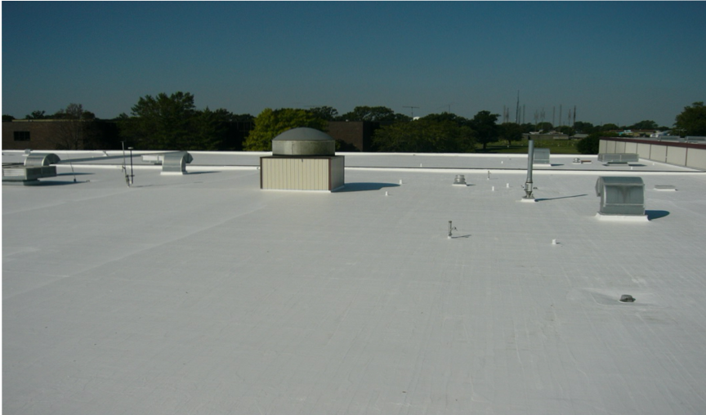
Case Study #3
Before Application: Ambient Temp= 82°F, SR= 0.35, Surface Temp= 141°F
After Application: Ambient Temp= 83°F, SR=0.81, Surface Temp= 98°F
Comparing August ‘06 to August ’07: KWH/day reduction of 7.3%, Energy $/day reduction of 9.4% (difference due to demand charge reduction)
Notes:
Before application of the reflective coating the Solar Reflectance of the aluminum coating was 0.35. This resulted in a roof surface temperature of 141°F when the ambient air temperature was 82°F.
After application of the reflective roof coating which had a Solar Reflectance of .081 the rooftop temperature was reduced to 98°F at a similar ambient air temperature of 83°F.
Comparing records from the previous year showed a 7.3% reduction in kilowatt usage and an energy coat savings of 9.4%.

Slide 52


Case Study #4
Sustainable Roofing
190,000 sq.ft. Maintained vs. Replaced
Notes:
Our next case study involves Sustainable Roofing & the Impact On The Environment.
A steel manufacturer outside of Harrisburg PA was planning to replace a corroded metal roof.
After determining that the corrosion was not a structural concern, the roof was cleaned, primed with a rust inhibitive primer and a 2 coat acrylic coating was installed.
The result was that 190,000 square feet of metal was kept out of the landfill and the roof was restored for continued long term use.

Slide 53

Case Study #5
Sustainable Roofing
122,800 sq. ft.
Fluid Applied Roof System Installed - 2003 Renewed - 2014
Notes:
In 2003, this manufacturers considered several options for their metal roofs. The roofs were showing signs of rust, leaks and general aging. After review, the roof was found to be in sound condition, requiring typical metal roof maintenance , ie, replacing backed out or missing fasteners, crimped corrugations, etc, prior to installing a sustainable system. A Fluid Applied System was determined to be a cost effective solution. The system included rust inhibitive priming, sealing all panel laps and seams along with a two coat Acrylic System at 21 dft (dry film thickness). After 11 years of protection, the owners decided to move forward with a Renewable Warranty option provided by the manufacturer. Pressure washing, minor repairs and installation of a single coat of the Elastomeric Finish Coat will provide this owner with an additional 10 Years of protection. The number of “Renewable” cycles is still yet to be determined in the industry, however, if the metal is continuously protected, it is logical to consider multiple cycles. Extending the original roof life expectancy dramatically

Slide 54


Case Study #6
Cost Effective Sustainable Roofing
20,000 sq. ft. High Rise
Notes:
Our final case study looks at the effect of physical building design relative to cost savings with sustainable roofing systems.
Remember this project from earlier with the minimal staging area a high height?
When Property Managers at Waverly on Lake Eola were researching options to bring their existing granular APP Modified roof system in a warrantable condition they found that 22 story height greatly increased the cost for conventional
re-roofing.
Initial budget estimates for a new single ply membrane were in the $22-27/square foot range.
Waverly on Lake Eola eventually installed a 15 year renewable Silicone reflective roof system at a final cost of $5.75/sq ft. This resulted in a savings of $400,000.00 and the 15 year warranty was renewable rather than term, so future warranty extensions will be available. The installation cost for the silicone coating solution was reduced compared to conventional low slope roofing assemblies. The key factors attributed to the cost savings include the ease of staging and delivering materials to the roof, the ease of installation based on the number of penetrations and details to treat, as well as the multiple roof elevations.

Slide 55



Thank You!
This concludes the continuing education portion of the presentation.

Slide 56

The better choice for architectural metal panels is:
  Field Applied Paint
  Silicone
  Aluminum Coatings
  Polyurethane
Online Quiz Questions
Notes:
Correct Answer: a) Field applied paint.
Feedback for Incorrect Answer: Protective coatings are better suited to structural metal panels while field applied paint are better suited for architectural metal panels.

Slide 57
Which coating technology will offer higher reflectivity properties?
  Asphalt
  Aluminum
  Acrylic
  All of the above
Online Quiz Questions
Notes:
Correct Answer: c) Acrylic
Feedback for Incorrect Answer: Of the technologies we discussed, asphalt and aluminums offer lower reflectivity than Acrylic, Silicone or Polyurethane coatings.

Slide 58
Which of the following are benefits of reflective roofing coatings?
  Enhanced roof performance
  Energy Savings
  Helps the environment
  All of the above
Online Quiz Questions
Notes:
Correct Answer: D) All of the above
Feedback for incorrect answer: All are benefits of reflective coatings

Slide 59
What is the definition of solar reflective index (SRI) ?
  a measure of the roof's ability to reject solar heat and uses a scale from 0 to 100. Materials that absorb and retain solar radiation have a lower number, while highly reflective materials have a higher number. SRI is referred to in LEED, ASHRAE and ICC
  the ability of the roof surface to release heat from the roof back into the air. Typically expressed in decimal format (i.e., 0.90)
  the ability of the roof surface to reflect solar radiation. Typically expressed in decimal format (i.e., 0.70)
  None of the above
Online Quiz Questions
Notes:
Correct Answer: A) a measure of the roof's ability to reject solar heat and uses a scale from 0 to 100. Materials that absorb and retain solar radiation have a lower number, while highly reflective materials have a higher number. SRI is referred to in LEED, ASHRAE and ICC
Feedback for incorrect answer: B is the definition of solar reflectance, C is the definition of thermal emissivity.

Slide 60
What is a sustainable roof?
  Conserves energy by improving the thermal efficiency of roofs
  Extends roof life span by improving long-term performance
  Minimizes the burden on the environment by using the earth’s resources responsibly
  All of the above
Online Quiz Questions
Notes:
Correct Answer: D) All of the above
Feedback for incorrect answer: A,B, & C are all part of a sustainable roof.

Slide 61
Which of the following are part of the roof condition survey?
  Structural viability of roof assembly
  Roof Assembly meets current code requirements
  Moisture Survey/Roof Core Sampling
  All of the above
Online Quiz Questions
Notes:
Correct Answer: D) All of the above
Feedback for incorrect answer: A,B & C are all part of the roof condition survey.

Slide 62
When qualifying a manufacturer for a sustainable solution which is NOT part of the qualifications?
  Financially stable
  Years of experience in technology
  Experienced sales force
  Both A & B
Online Quiz Questions
Notes:
Correct Answer: D) Both A & B
Feedback for incorrect answer: Although an experienced sales force is beneficial, it does not play a role in evaluating a manufacturer for long term support of the warranty.

Slide 63
When selecting a contractor for application of a sustainable solution, which of the following are important for a successful installation?
  Manufacturer Training
  Experience In The Technology Selected
  Licensing & Insurance Requirement
  All of the above
Online Quiz Questions
Notes:
Correct Answer: D) All of the above
Feedback for incorrect answer: All are part of the contractor selection process.

Slide 64
Which of the following technologies may be difficult to recoat?
  Silicone
  Water Based Acrylic
  Aluminum Coating
  None of the above
Online Quiz Questions
Notes:
Correct Answer: A) Silicone
Feedback for incorrect answer: Although adhesion pull tests are required when evaluating a roof that is already coated, silicone technology is known to have difficulty when attempting to recoat. Water based acrylics and aluminum coating can be recoated easily after cleaning.

Slide 65
What are some of the key considerations when designing a sustainable solutions.
  Project Evaluation
  Exacting Specifications
  Preventative Maintenance Plan
  All of the above
Online Quiz Questions
Notes:
Correct Answer: d) All of the above
Feedback for incorrect answer: All are important considerations for designing and maintaining sustainable solutions.

